Slide 1
Invasive Species Population Dynamics
Modeling Stratified Diffusion in Biological Invasions by Shigesada et al. (1995)

Slide 2
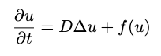
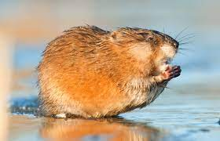
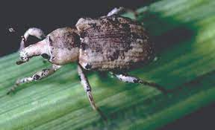
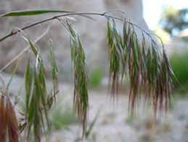
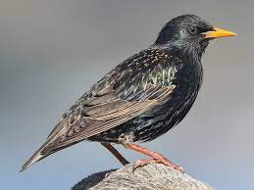
Shigesada et al. 1995
Population Dynamics
Mathematical Modeling Ecological Events
The Reaction Diffusion (KPP) PDE
Von Forester PDE
North American Muskrat
Rice Water Weevil
Cheat Grass
European Starling
Notes:
I read a paper about invasive species population dynamics. They took well documented data from previous invasions and tried to mathematically model various ecological events.
They used models based off the KPP PDE and then the traveling wave Von Forester PDE.

Slide 3
Agenda
Discuss Ecological Background
Introduce Questions
Analyze the Short Distance Dispersal
Preview the Stratified Diffusion Model
North American Muskrat
Rice Water Weevil
Cheat Grass
European Starling

Slide 4
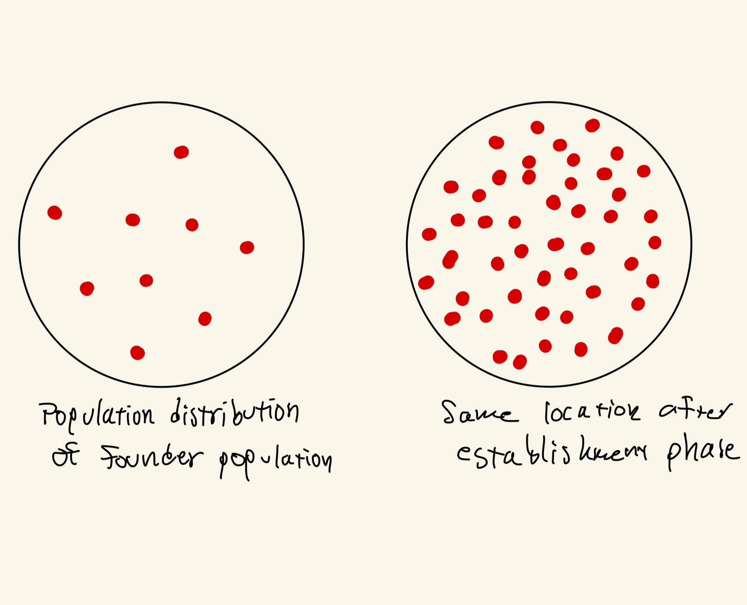
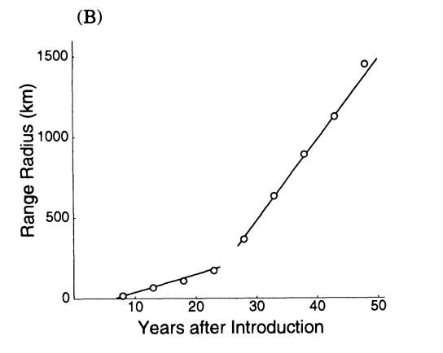
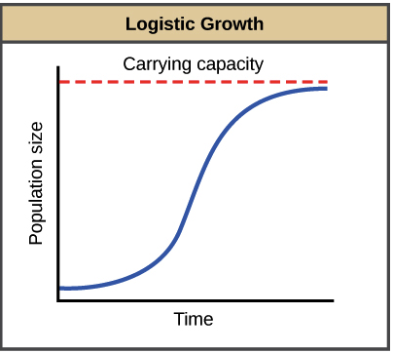
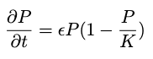
Phases of Invasions
Establishment Phase
The period between the founding of a population and the detection of such population.
Range Expansion
The spread of a population into previously unoccupied regions. In invasions, the spread often accelerates due to various factors.
Saturation (Logistic Growth)
Notes:
Saturation is ignored to simplify the PDE. If we use logistic growth, the PDE becomes nonlinear and thus much more difficult to solve. Also, saturation isn’t a huge focus of invasive species dynamics. The main point of this paper was to discover a speed of expansion, rather than to model the actual population size.

Slide 5
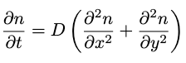
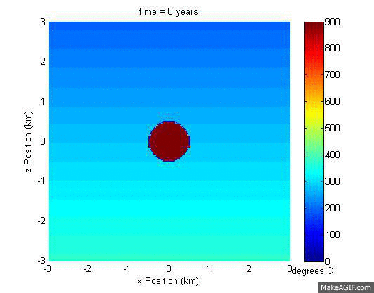
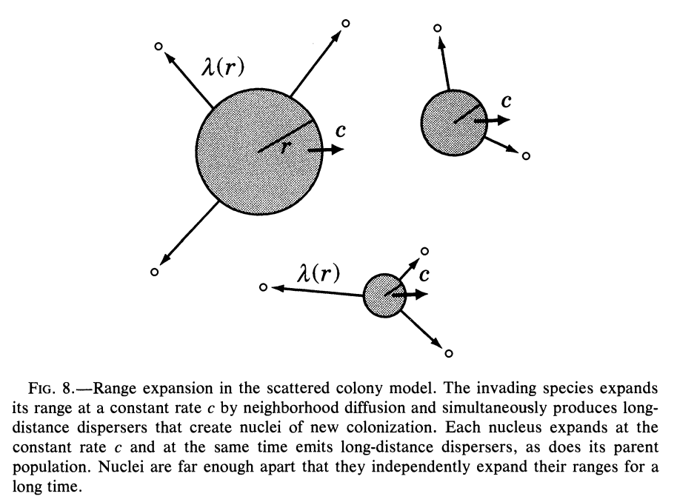
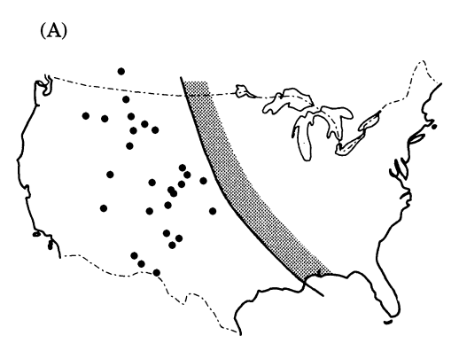
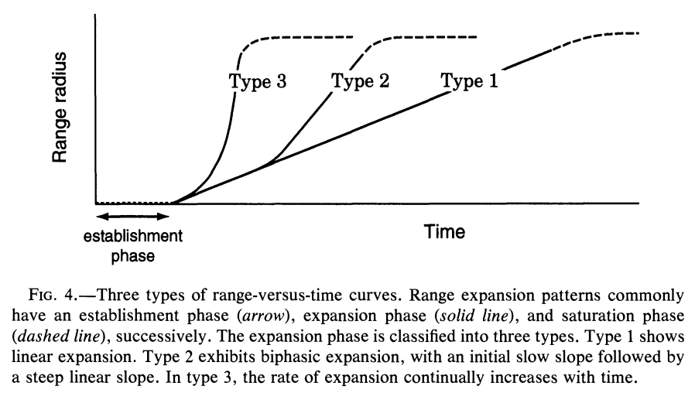
Means of Range Expansion
Neighborhood Diffusion (ND)
Members of a population spreading out locally
Long Distance Migration (LDM)
Members of a population moving large distances to establish new colonies
Stratified Diffusion (SD)
A population expands with a combination of ND and LDM

Slide 6
Questions
Part 1 – Short Distance Dispersal Model
What dictates the existence and duration of an establishment phase?
How quickly does the range of an invasive species expand?
Part 2 – Stratified Diffusion Model
How do we model stratified diffusion?

Slide 7
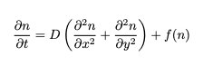
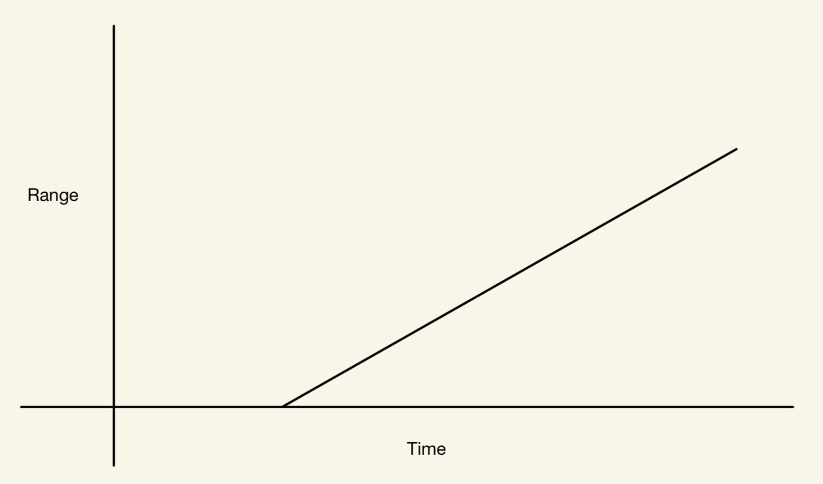
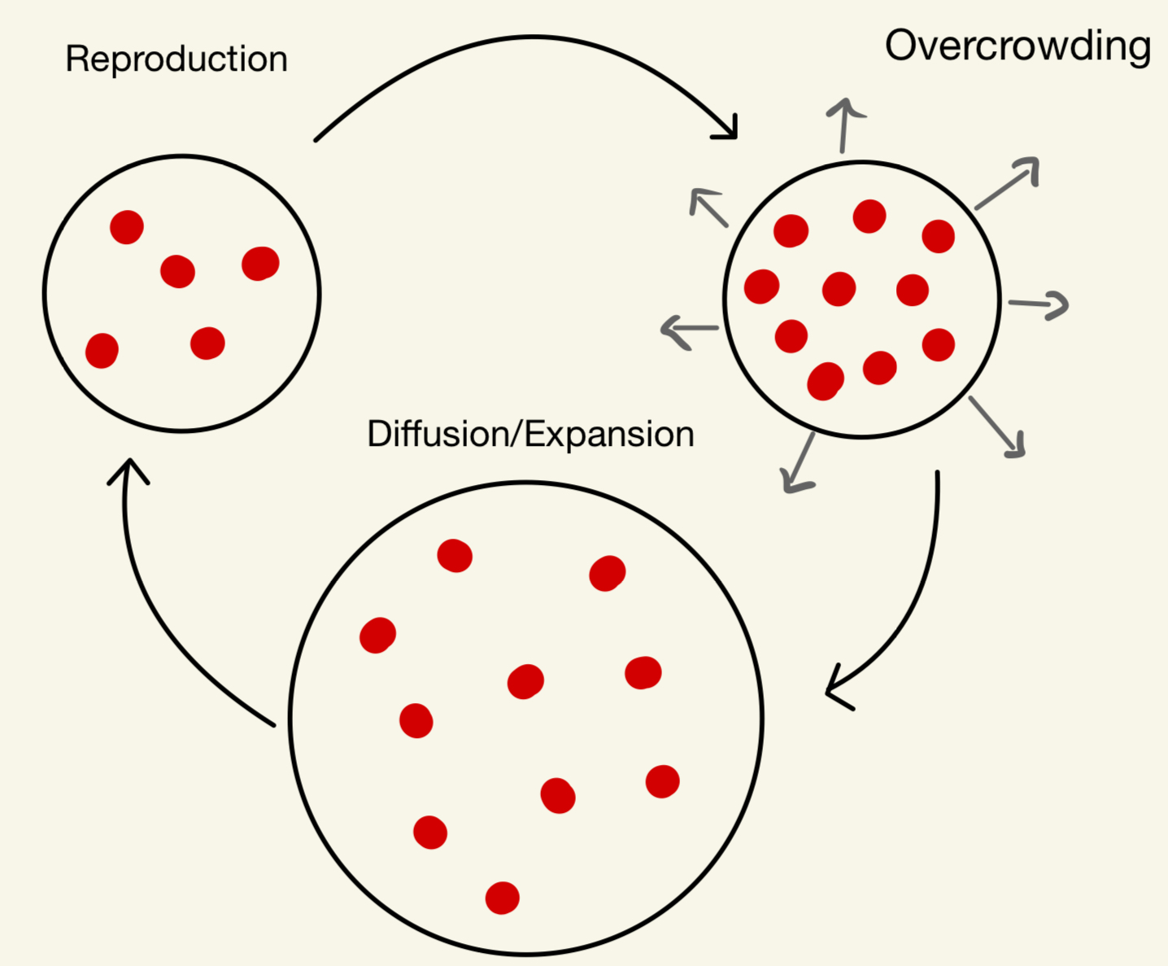
Short Distance Dispersal
Reaction Diffusion (KPP) Equation
Neighborhood Diffusion
Notes:
In a way, this is a simple model that introduced us to the role that the diffusion reaction equation plays. This model assumes that a population’s range expansion is dominated by neighborhood diffusion which is common in slow, grounded animals like the North American Muskrat. When we get to the notion of detectability, we can see how an establishment period can occur.

Slide 8
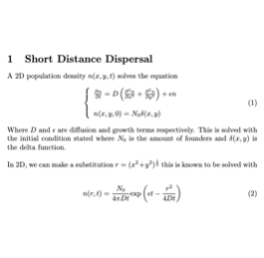


Model Foundation
The founding population is represented with a delta function to show that the population density is 1 only at that point.

Slide 9
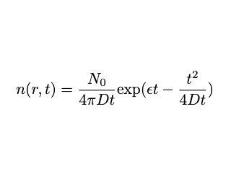
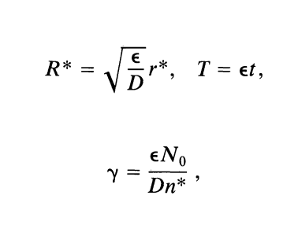
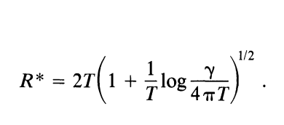

Establishment Phase
This comes from fixing a minimum detection density, say n*(r*, t) where r* is the radius at which the minimum detection density n* is achieved.
Using these substitutions, we nondimensionalize

Slide 10
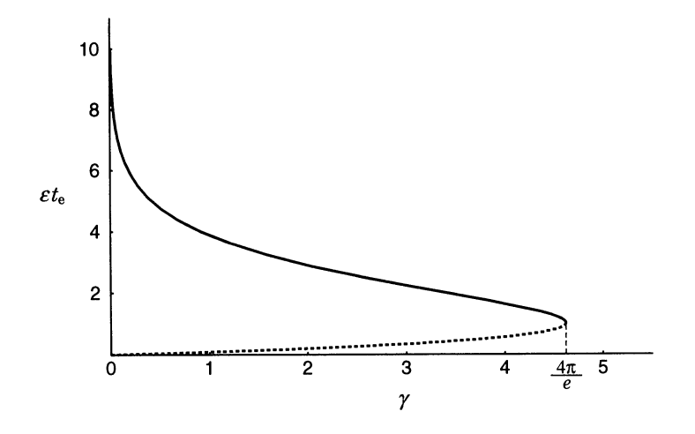
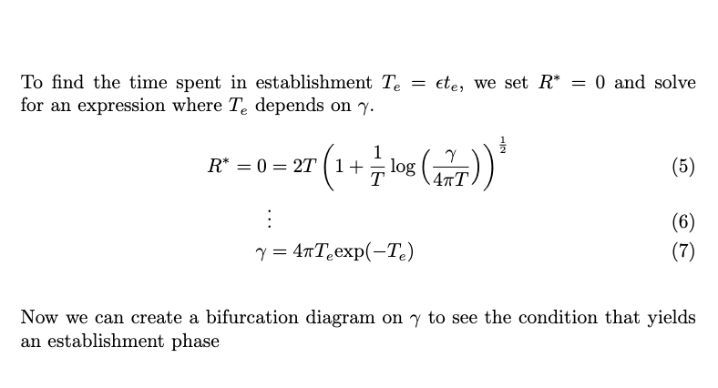
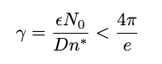
Establishment Phase Condition
Establishment Phase Bifurcation Diagram
Any gamma exceeding 4π/e will skip the establishment phase

Slide 11
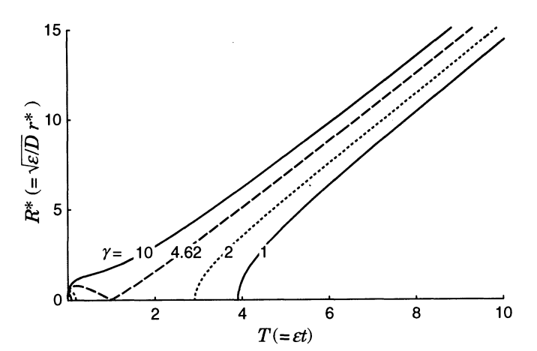
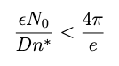
Establishment Period
Since n* is fixed, we can make a radius vs. time graph and see that the existence of an establishment period depends on…
Notes:
So, if epsilon is sufficiently smaller than D, then we will see an establishment period whose length can be calculated.

Slide 12
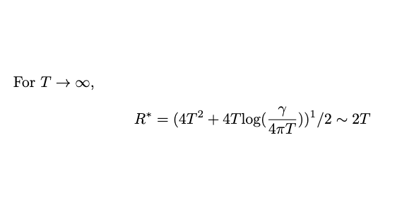
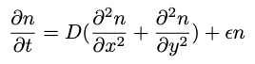
Long Term Behavior
Linearity of R* vs T Graph
What is the speed?
Take the limit of R*
dR*/dT = 2
Re-dimensionalize
dr*/dt = 2√εD
Recall the PDE →
Notes:
Notice the linearity of the R* vs T graph. Since R* is the radius at which we achieve our minimum detection density, we can think of R* as the frontier of our population. It suggests that the radius of our population frontier expands linearly as we send time to infinity. We can even determine the speed at which this happens.
Taking the limit of R* as T approaches infinity, we can see that this product term is negligible and leaves us with 2T.
Re-dimentionalizing gives us a long-term speed with the coefficients from our original PDE. So in context, we see that the advancement of our frontier depends on the reproduction rate and diffusion speed.

Slide 13
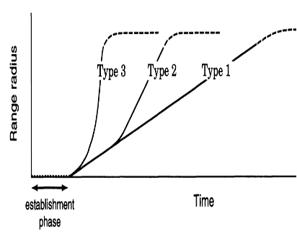
Recap
Identified Establishment Phase Criterion
Determined Long-Term Behavior of the Short Distance Dispersal Model
Classified the Short Distance Dispersal Model as Type 1

Slide 14
Long Distance Migration and Stratified Diffusion
Long Distance Migration (LDM): Members of a population that move large distances to establish new colonies
Stratified Diffusion: The incorporation of LDM into the ND model
Notes:
Long distance Migration is the main distinction that separates type 2 and 3 expansion patterns from the type 1 pattern we just explored.

Slide 15
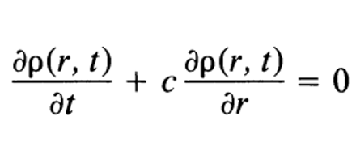
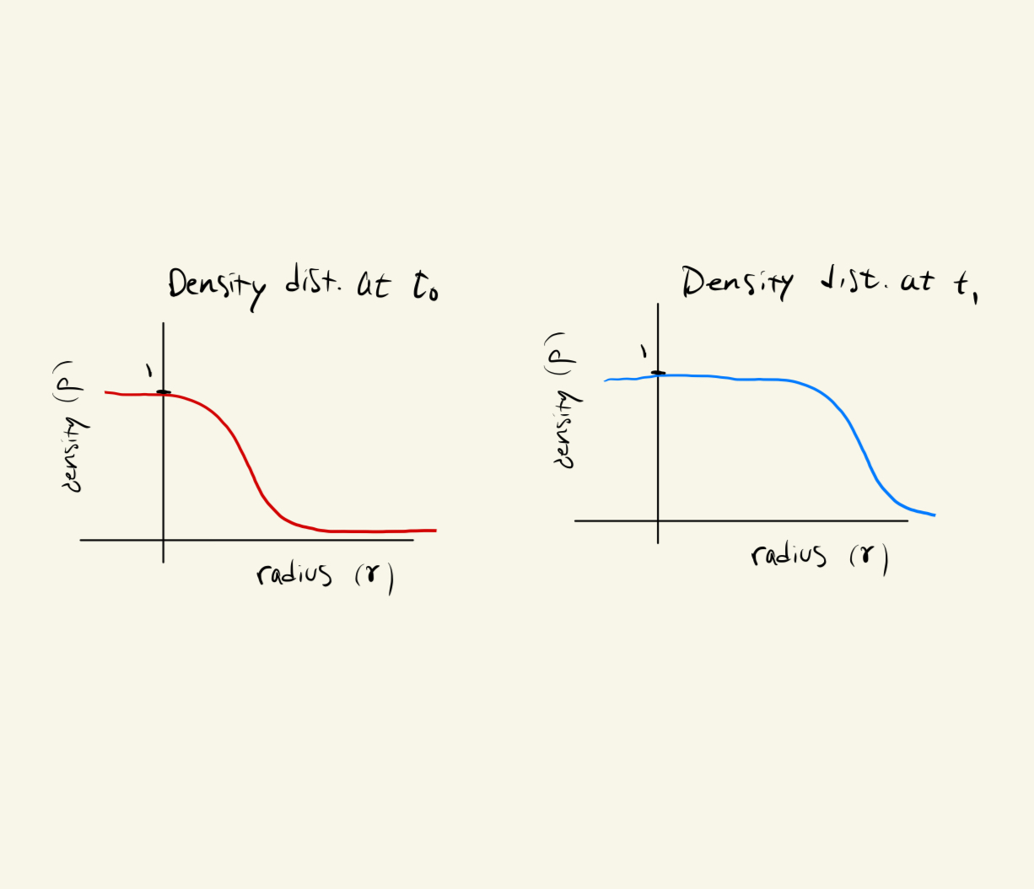
Von Forester Equation
Wave transport solution

Slide 16
Conclusion
Modeled Short Distance Dispersal
Neighborhood Diffusion

Slide 17
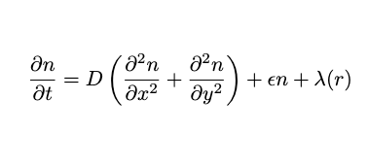
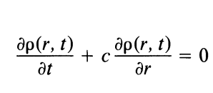

LDM Model Integration
KPP no longer applies with offspring colonies
Von Forester Equation
Notes:
These colonies function as their own diffusive and reactive systems.
We are tasked to model a more complicated, disjoint population range which can no longer be simplified to the diffusion of an initial population concentration. KPP no longer applies

Slide 18
Von Forester Equation
Problem: This assumes that we can simplify the 2D KPP into a radial traveling wave solution (TWS). Is this true? How is this justified?
For simplicity, think of ρ(r, t) as a population density.

Slide 19
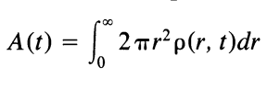
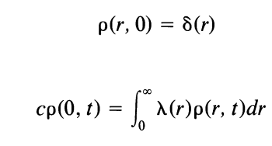
Area Function Conversion
Integrate size distribution function
Area vs. Time function with delta function IC and BC dependent on successful LDM λ(r).
What is the form of λ(r)?

Slide 20
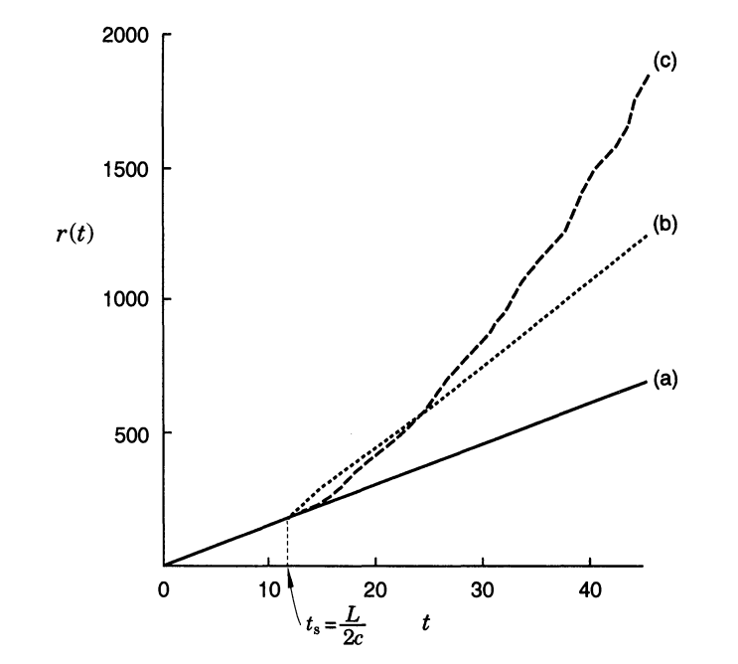
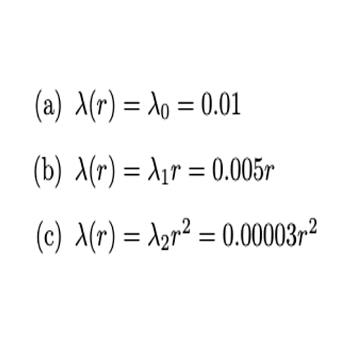
λ(r)
Notes:
Each lambda supposes that successful colonies are established according to different properties.
The first supposes it’s constant regardless of range.
The second supposes that the radius dictates long distance colonization which suggests that only members on the outskirts of the geographic range can contribute to long distance colonization.
Finally, the third suggests that the area of the range dictates the success of long-distance migrants.

Slide 21
Conclusion
We have found mathematical models that fit the three naturally observed expansion patterns of invasive species

